Slide 1
TensorFlow tutorial: Image classification using CNN
Soo Kim
Lawrence Livermore National Laboratories

Slide 2
Outline
Install tensorflow-gpu
Getting started: Graph and Session
CNN for MNIST classification
CNN for hurricane classification
Lecture note and code: https://github.com/kim79sookyung/KISTI_lab
Sources: Tensorflow for deep learning research: https://web.stanford.edu/class/cs20si/2017/
MNIST for ML Beginner: https://www.tensorflow.org/tutorials/

Slide 3
Install TensorFlow-gpu
http://conda.io/miniconda.html
위의 사이트에서 Linux 64 bit(python 2.7)의 miniconda installer (.sh file)를 다운받습니다.
다음의 커멘드로도 실행이 가능합니다.
wget https://repo.continuum.io/miniconda/Miniconda2-latest-Linux-x86_64.sh
bash Miniconda2-latest-Linux-x86_64.sh

Slide 4
Install TensorFlow-gpu
그러면 miniconda2 폴더가 생기고, miniconda2/bin 의 위치를 PATH로 지정합니다.
export PATH="$HOME/miniconda2/bin:$PATH”
이제 conda environment를 생성한 후, GPU enabled tensorflow를 다음의 커멘드를 써서 설치 합니다.
conda create -n tensorflow python=2.7
source activate tensorflow
conda install -c anaconda cudnn tensorflow-gpu cudatoolkit=9.0

Slide 5
Install TensorFlow-gpu
위의 과정을 다 마쳤으면, 다음 커멘드를 써서, tensorflow-gpu가 제대로 설치되었는지 확인합니다.
#check whether gpu is actually working
python
import tensorflow as tf
sess = tf.Session(config=tf.ConfigProto(log_device_placement=True))

Slide 6
Install TensorFlow-gpu
==>Then it print out which gpus are actually working
위 과정을 성공적으로 마친후에,
컴퓨터에서 로그아웃 하고, 다시 로그인 해서 tensorflow 를 사용 하려 할때는
아래의 커맨드를 쓰시면 됩니다.
export PATH="$HOME/miniconda2/bin:$PATH"
source activate tensorflow

Slide 7
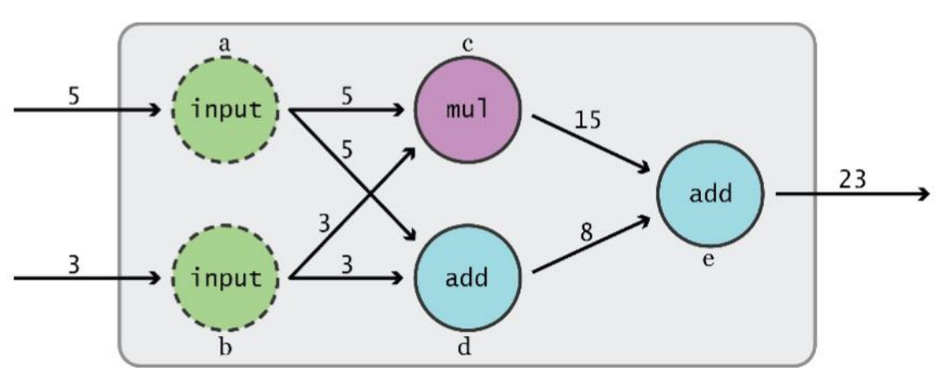
Data Flow Graphs
TensorFlow separates definition of computations from their execution
Phase 1: assemble a graph
Phase 2: use a session to execute operations in the graph.

Slide 8
Start tensorFlow
export PATH="$HOME/miniconda2/bin:$PATH”
source activate tensorflow

Slide 9
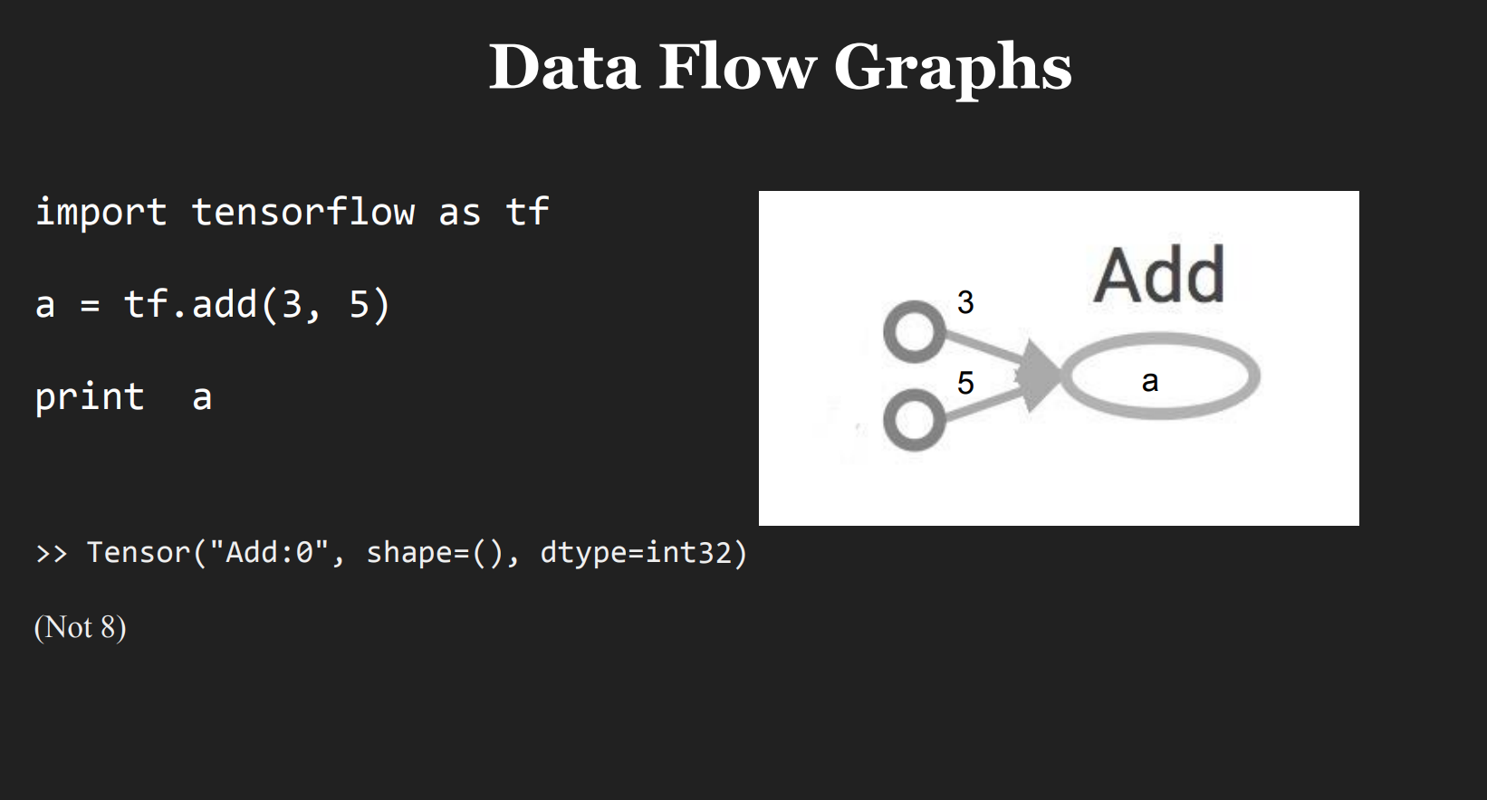

Slide 10
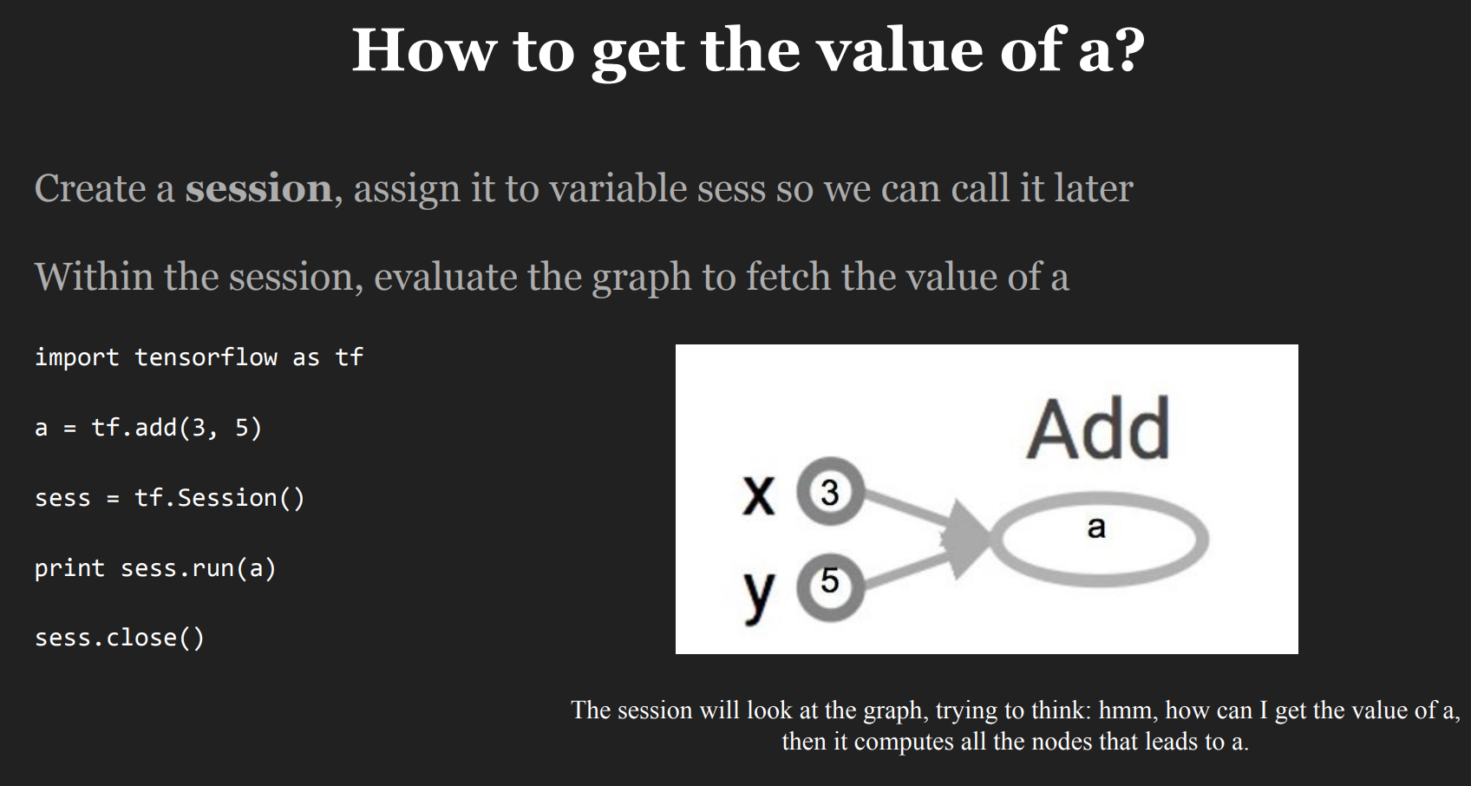
Notes:
세션은 텐서를 플로우 시킨후에 값을 출력한다.

Slide 11
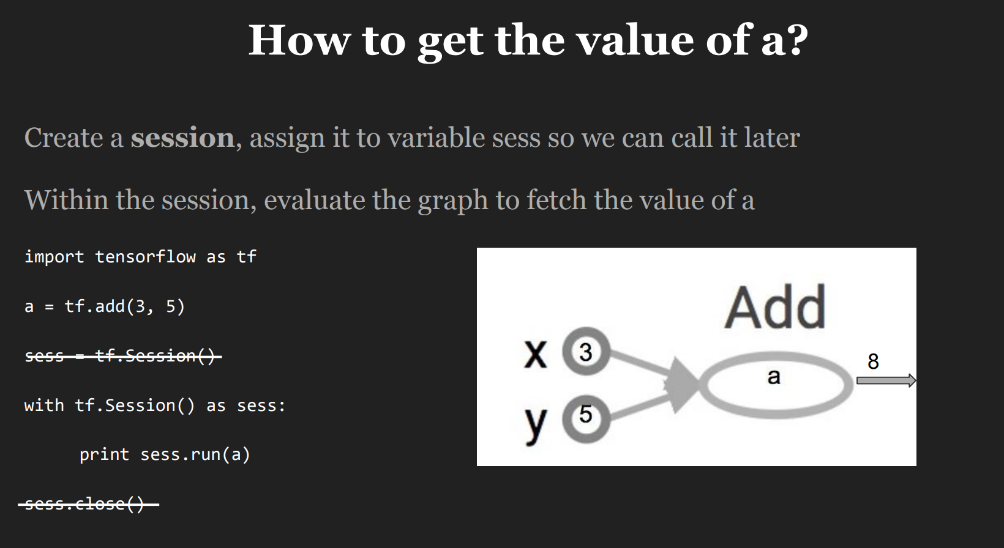
A Session object encapsulates the environment in which Operation objects are executed, and Tensor objects are evaluated.

Slide 12
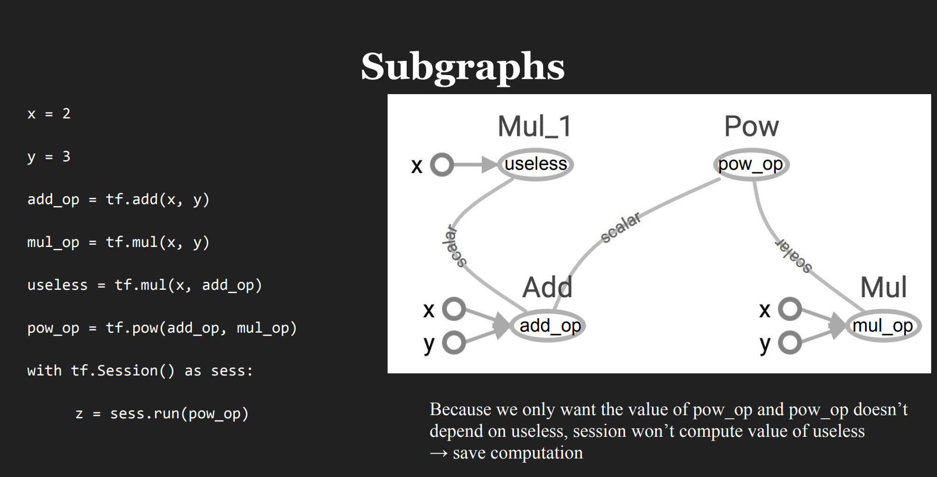

Slide 13
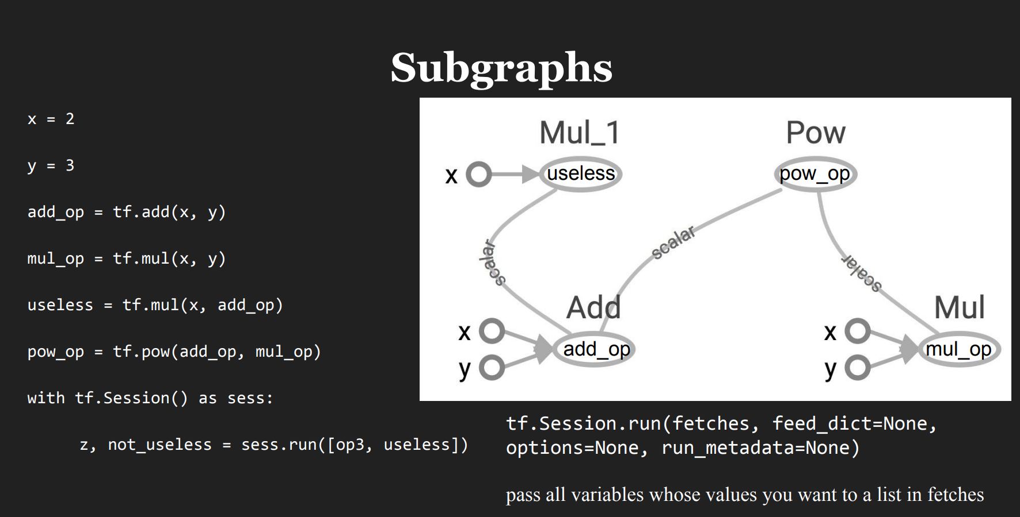

Slide 14
CNN for MNIST classification
https://github.com/aymericdamien/TensorFlow-Examples/blob/master/examples/3_NeuralNetworks/convolutional_network.py

Slide 15
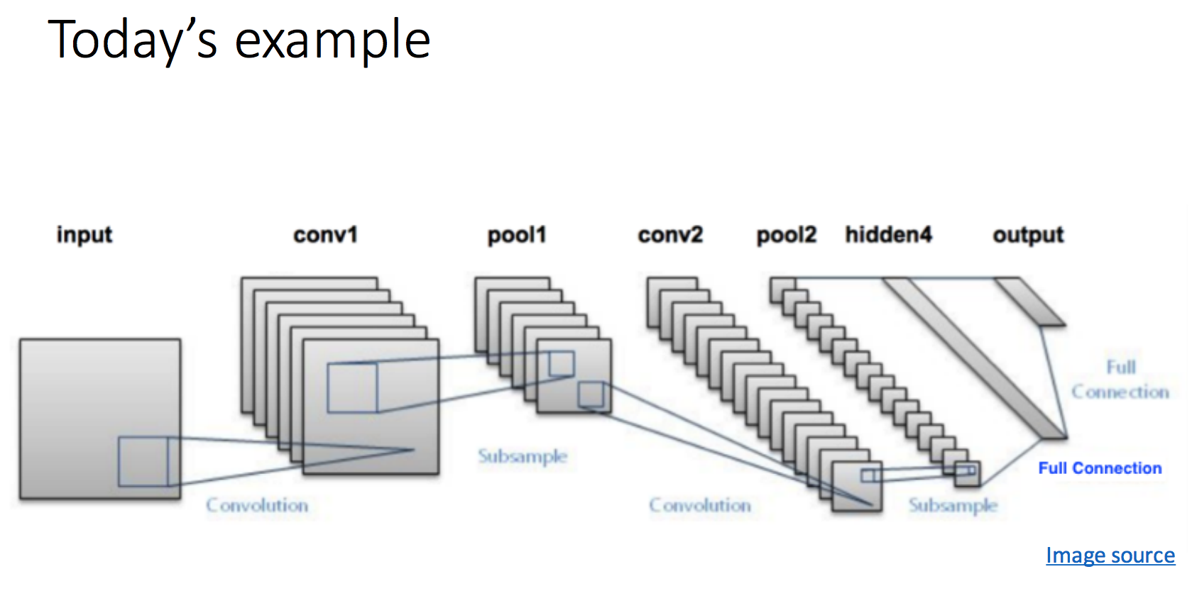
CNN for MNIST classification
https://github.com/aymericdamien/TensorFlow-Examples/blob/master/examples/3_NeuralNetworks/convolutional_network.py

Slide 16
Tensorflow implementation
Weight Initialization
Convolution and Pooling
Fully connected layer
Readout Layer
https://github.com/aymericdamien/TensorFlow-Examples/blob/master/examples/3_NeuralNetworks/convolutional_network.py

Slide 17
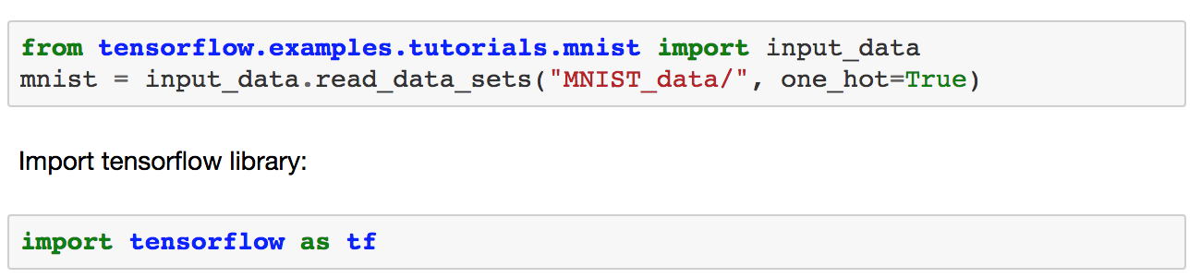
# Start TensorFlow Interactive Session
sess = tf.InteractiveSession()
https://github.com/aymericdamien/TensorFlow-Examples/blob/master/examples/3_NeuralNetworks/convolutional_network.py
Notes:
Difference btw tf.InteractiveSession() and tf.Session()
This allows to use interactive context, like shell, as it avoids having to pass an explicit Session object to run op:
sess = tf.InteractiveSession() a = tf.constant(5.0) b = tf.constant(6.0) c = a * b # We can just use 'c.eval()' without passing 'sess' print(c.eval()) sess.close() It is also possible to say, that InteractiveSession supports less typing, as allows to run variables without needing to constantly refer to the session object.

Slide 18
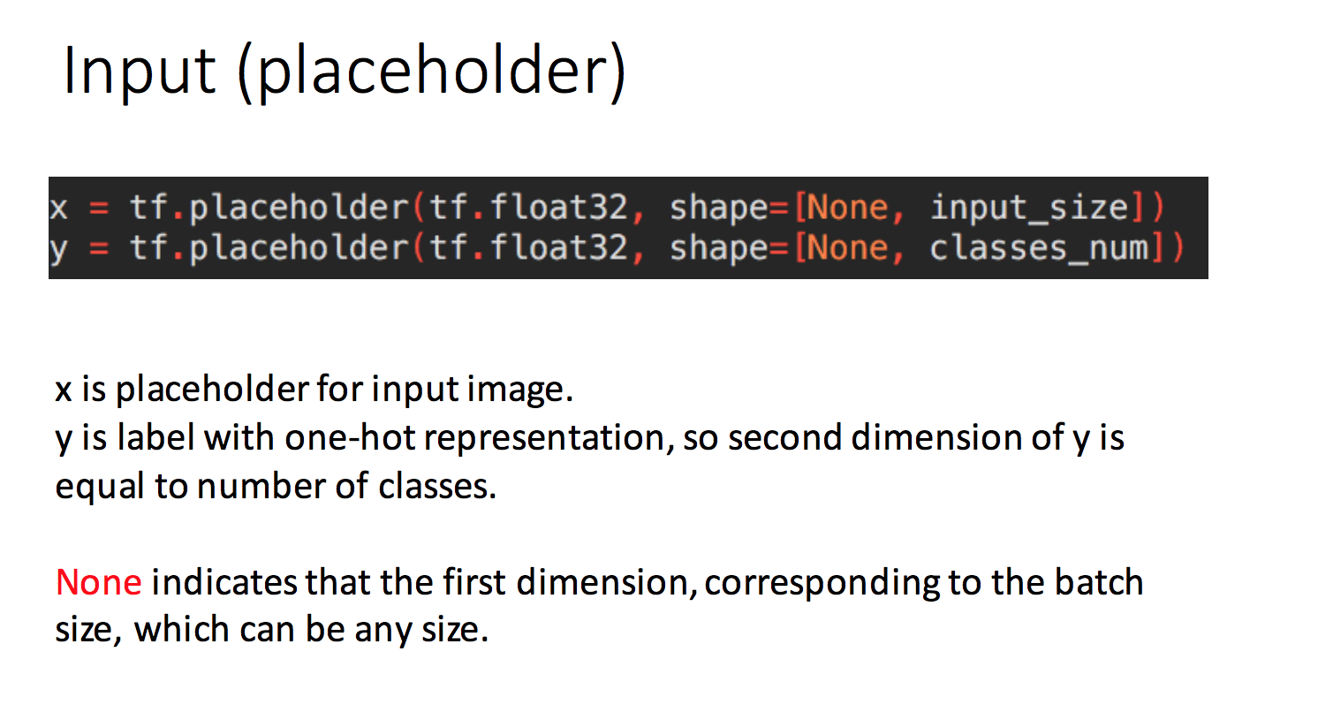
https://github.com/aymericdamien/TensorFlow-Examples/blob/master/examples/3_NeuralNetworks/convolutional_network.py
Notes:
x isn't a specific value. It's a placeholder, a value that we'll input when we ask TensorFlow to run a computation.
그래프에서 인풋을 넣을수 있는 어떠한 상자.
**placeholder is simply a variable that we will assign data to at a later date. It allows us to create our operations and build our computation graph, without needing the data.
We want to be able to input any number of MNIST images, each flattened into a 784-dimensional vector. We represent this as a 2-D tensor of floating-point numbers, with a shape [None, 784]. (Here None means that a dimension can be of any length.)

Slide 19
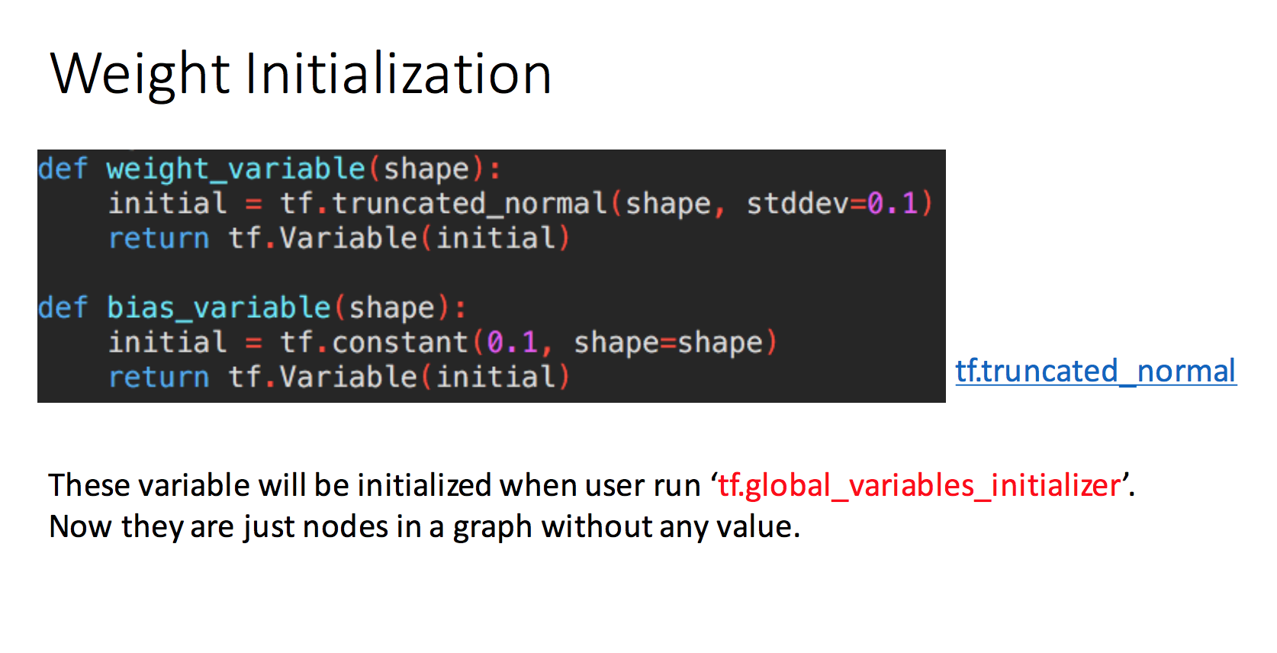
https://github.com/aymericdamien/TensorFlow-Examples/blob/master/examples/3_NeuralNetworks/convolutional_network.py
https://github.com/dguitarbite/deeplearningfun/blob/master/MNIST.py
Notes:
Tf.truncated_normal
Outputs random values from a truncated normal distribution.
The generated values follow a normal distribution with specified mean and standard deviation, except that values whose magnitude is more than 2 standard deviations from the mean are dropped and re-picked.
왜 노말 디스트리뷰션으로 이니셜라이즈 하나?
General ways to make it initialize better weights:
a) If you’re using ReLu activation function in the deep nets (I’m talking about the hidden layer’s output activation function) then:
Generate random sample of weights from a Gaussian distribution having mean 0 and a standard deviation of 1.
Multiply that sample with the square root of (2/ni). Where ni is number of input units for that layer.
왜 트런케이티드 디스트리뷰션으로 이니셜라이즈 하나?
The point for using truncated normal is to overcome saturation of tome functions like sigmoid (where if the value is too big/small, the neuron stops learning).

Slide 20
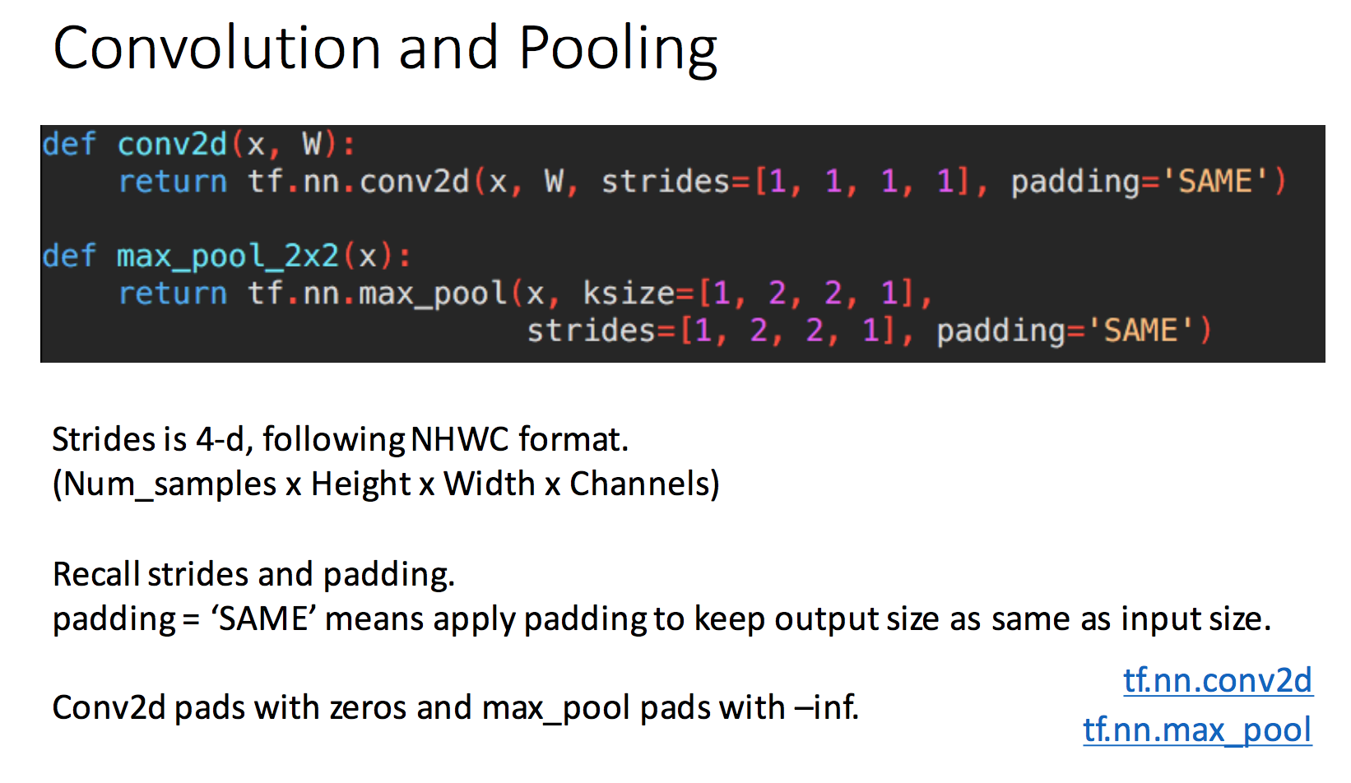
https://github.com/aymericdamien/TensorFlow-Examples/blob/master/examples/3_NeuralNetworks/convolutional_network.py
Notes:
https://www.tensorflow.org/api_docs/python/tf/nn/conv2d
Conv2d:
-Flattens the filter to a 2-D matrix with shape [filter_height * filter_width * in_channels, output_channels].
-Extracts image patches from the input tensor to form a virtual tensor of shape [batch, out_height, out_width, filter_height * filter_width * in_channels].
-For each patch, right-multiplies the filter matrix and the image patch vector.
https://www.tensorflow.org/versions/r1.0/api_docs/python/tf/nn/max_pool
value: A 4-D Tensor with shape [batch, height, width, channels] and type tf.float32.
ksize: A list of ints that has length >= 4. The size of the window for each dimension of the input tensor.
strides: A list of ints that has length >= 4. The stride of the sliding window for each dimension of the input tensor.
padding: A string, either 'VALID' or 'SAME'. The padding algorithm. See the comment here
data_format: A string. 'NHWC' and 'NCHW' are supported.
name: Optional name for the operation.

Slide 21
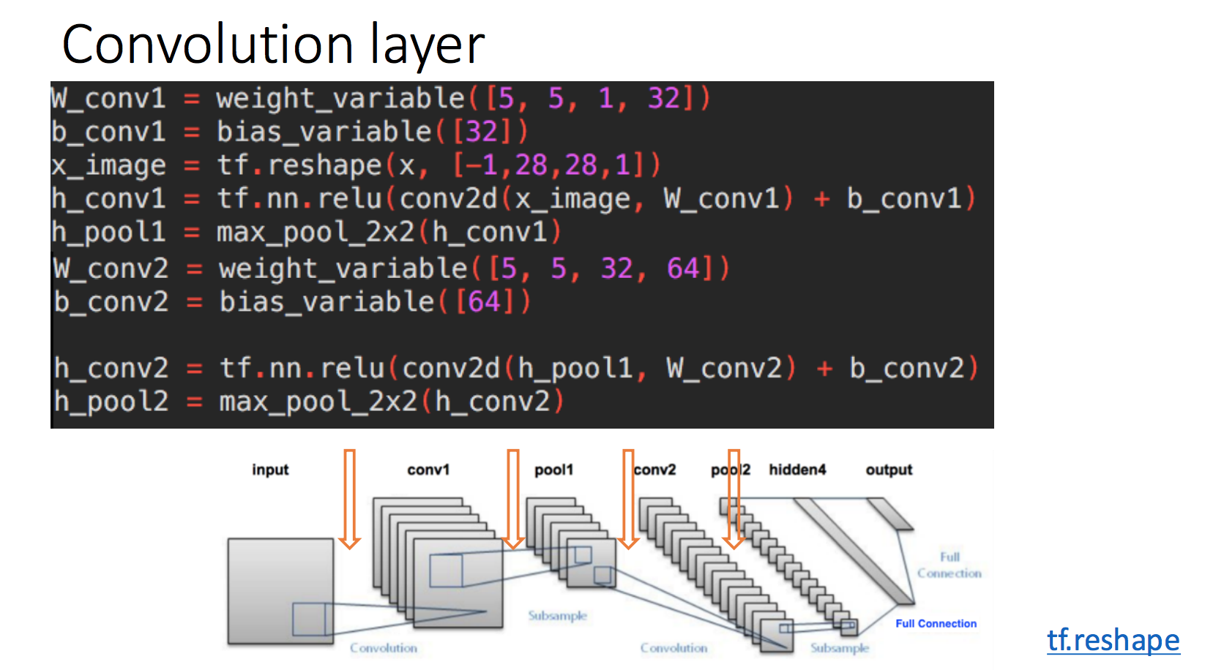
https://github.com/aymericdamien/TensorFlow-Examples/blob/master/examples/3_NeuralNetworks/convolutional_network.py

Slide 22
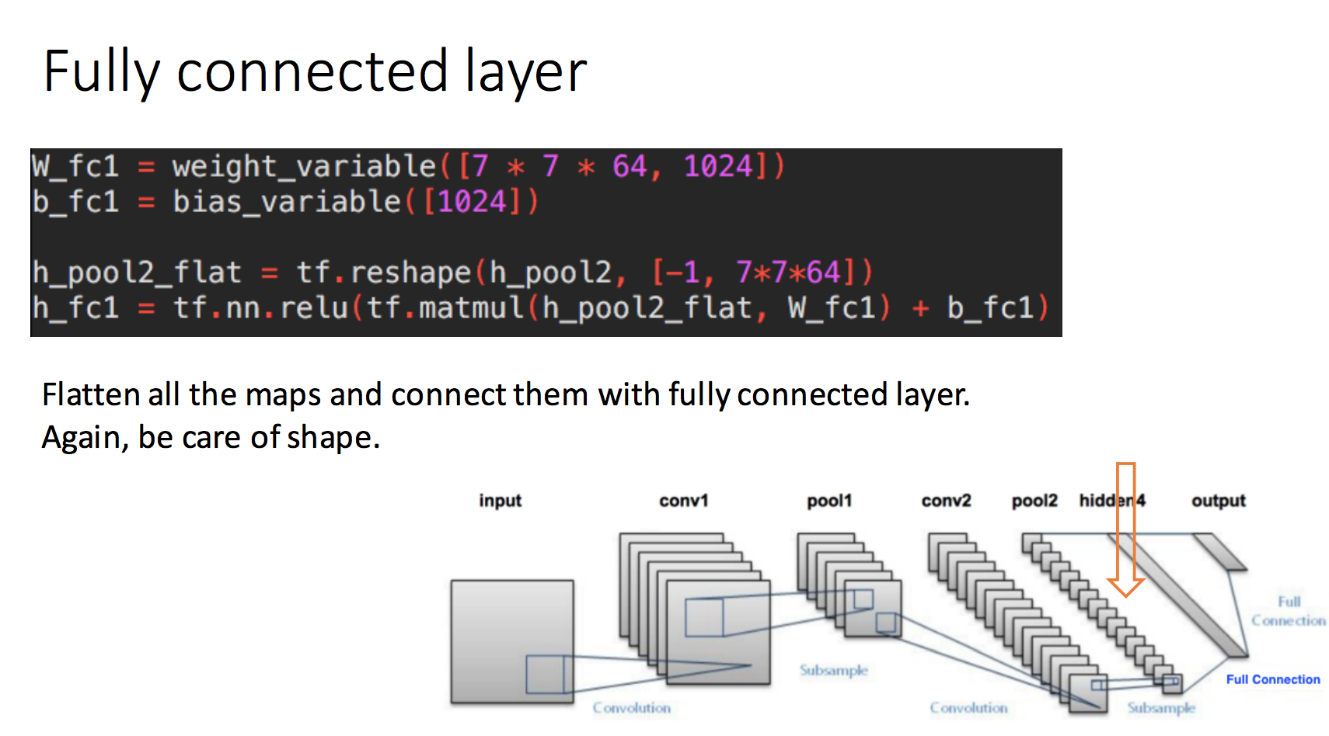
https://github.com/aymericdamien/TensorFlow-Examples/blob/master/examples/3_NeuralNetworks/convolutional_network.py

Slide 23
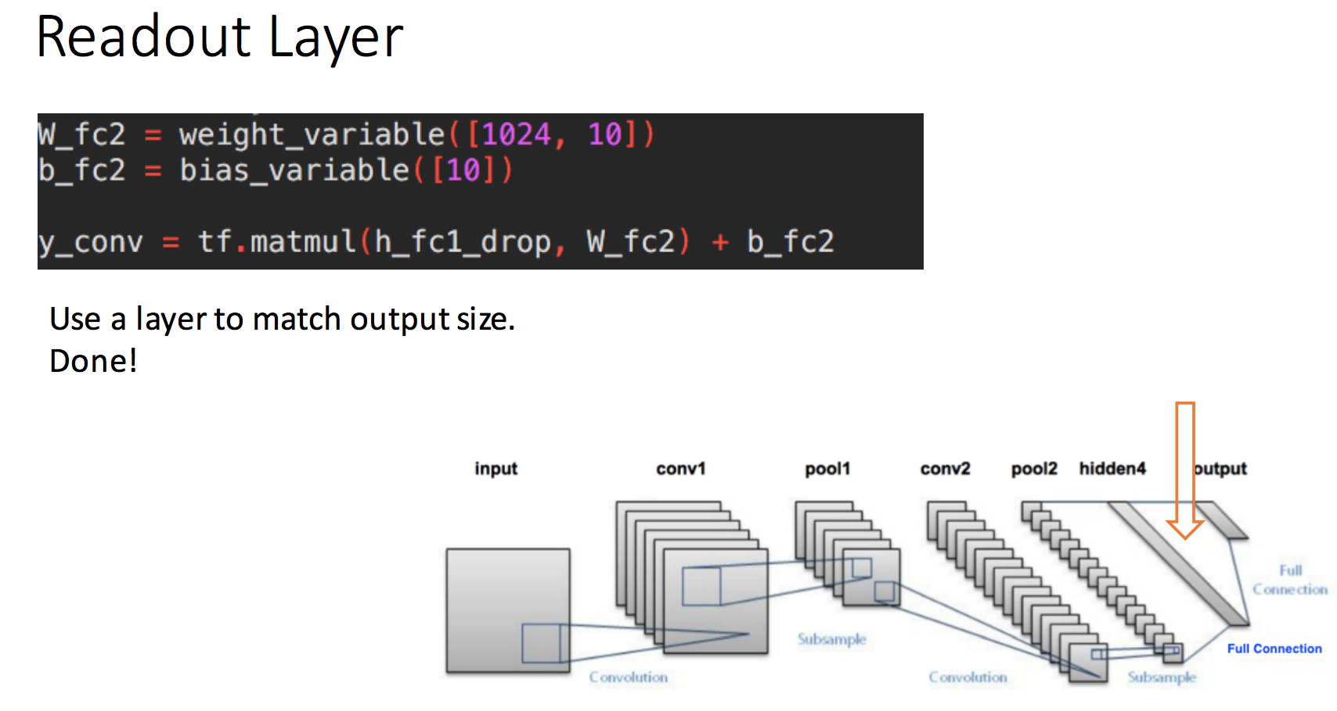
https://github.com/aymericdamien/TensorFlow-Examples/blob/master/examples/3_NeuralNetworks/convolutional_network.py

Slide 24
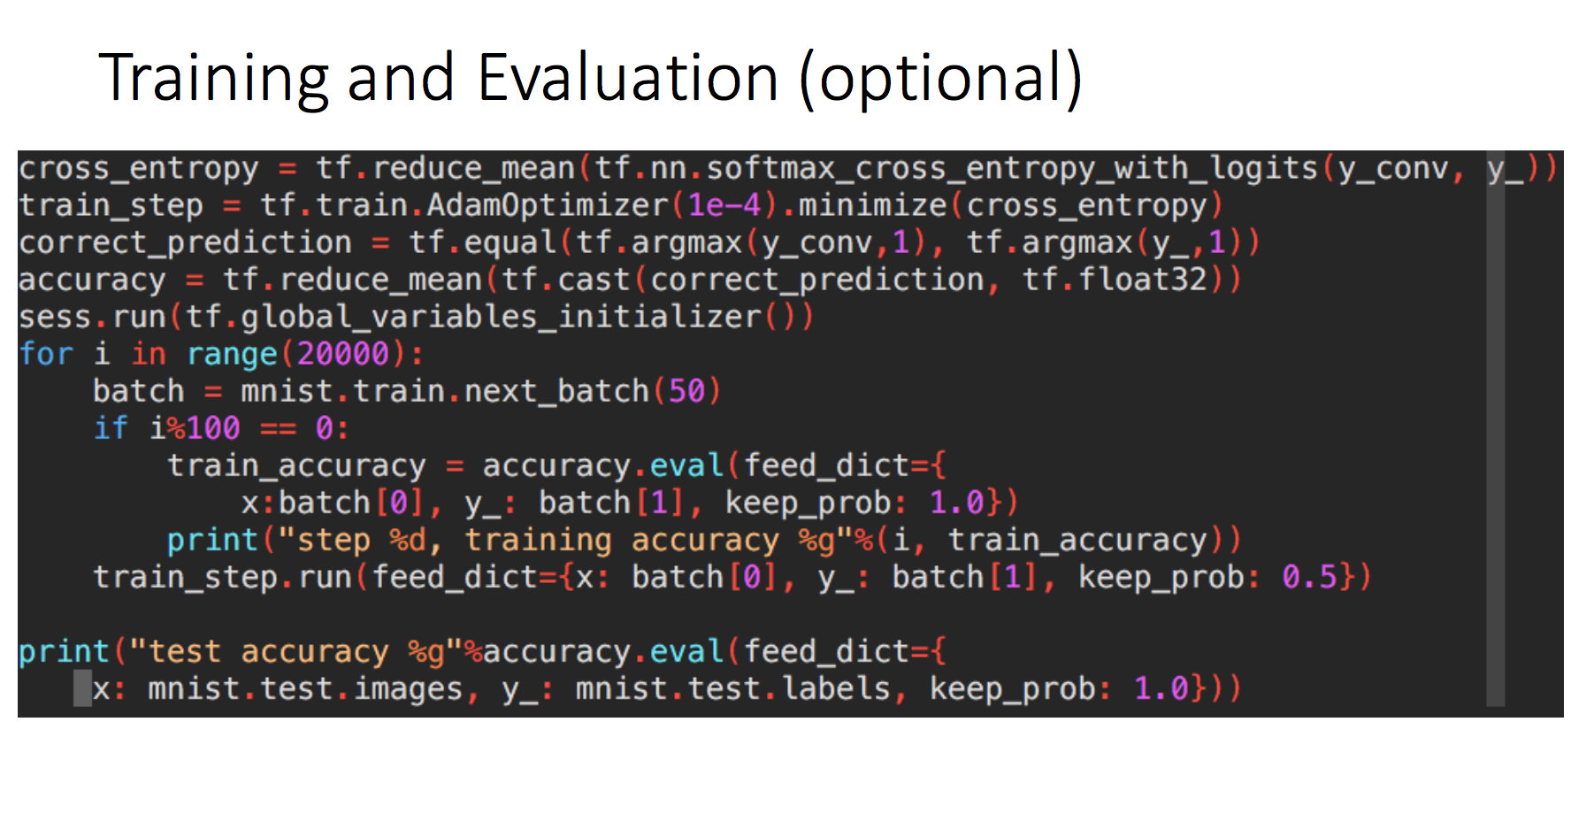
https://github.com/aymericdamien/TensorFlow-Examples/blob/master/examples/3_NeuralNetworks/convolutional_network.py
Notes:
(?)cross entropy between two probability distributions p and q measures the average number of bits needed to identify an event drawn from the set:
where p is the true distribution and q is the model distribution.
벳치로 트레이닝 하는 이유: (?)
In batch gradient descent, you compute the gradient over the entire dataset, averaging over potentially a vast amount of information. It takes lots of memory to do that. But the real handicap is the batch gradient trajectory land you in a bad spot (saddle point).
In pure SGD, on the other hand, you update your parameters by adding (minus sign) the gradient computed on a single instance of the dataset. Since it's based on one random data point, it's very noisy and may go off in a direction far from the batch gradient. However, the noisiness is exactly what you want in non-convex optimization, because it helps you escape from saddle points or local minima(Theorem 6 in [2]). The disadvantage is it's terribly inefficient and you need to loop over the entire dataset many times to find a good solution.
The minibatch methodology is a compromise that injects enough noise to each gradient update, while achieving a relative speedy convergence.

Slide 25
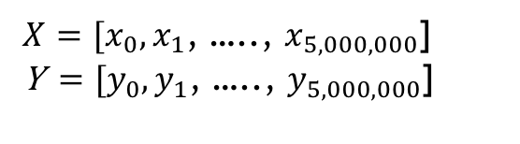
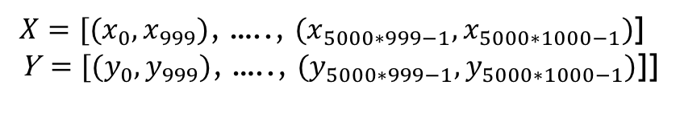
Batch vs Mini-batch gradient descent (optional)
1. Batch Gradient Descent
2. Mini-Batch Gradient Descent
$X=[x_{0},x_{1}$, ….., $x_{5,000,000}$] Y$=[y_{0},y_{1}$, ….., $y_{5,000,000}$]
$X=[{(x}_{0},x_{999})$, ….., ${(x}_{5000∗999−1},x_{5000∗1000−1})$] Y$=[{(y}_{0},y_{999})\text{, ….., }{(y}_{5000∗999−1},y_{5000∗1000−1})\text{]}$]
Train with (X,Y) for each epoch --> Memory intensive --> computing cost high
Train with ((x_{(i-1)*1000,} x_{i*1000}),(y_{(i-1)*1000,} y_{i*1000})) for each epoch batch-size=1000
Loss
Loss
Iterations
Iterations
Notes:
Batch vs Mini-batch gradient descent

